Slide 1
Data Structures
Sorting Technique – Introduction

Slide 2
Introduction

Slide 3
Data Structure – Sorting Techniques
Introduction
Sorting:
It is a process of arranging items systematically

Slide 4
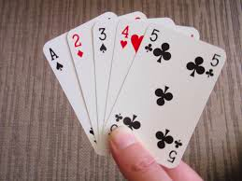
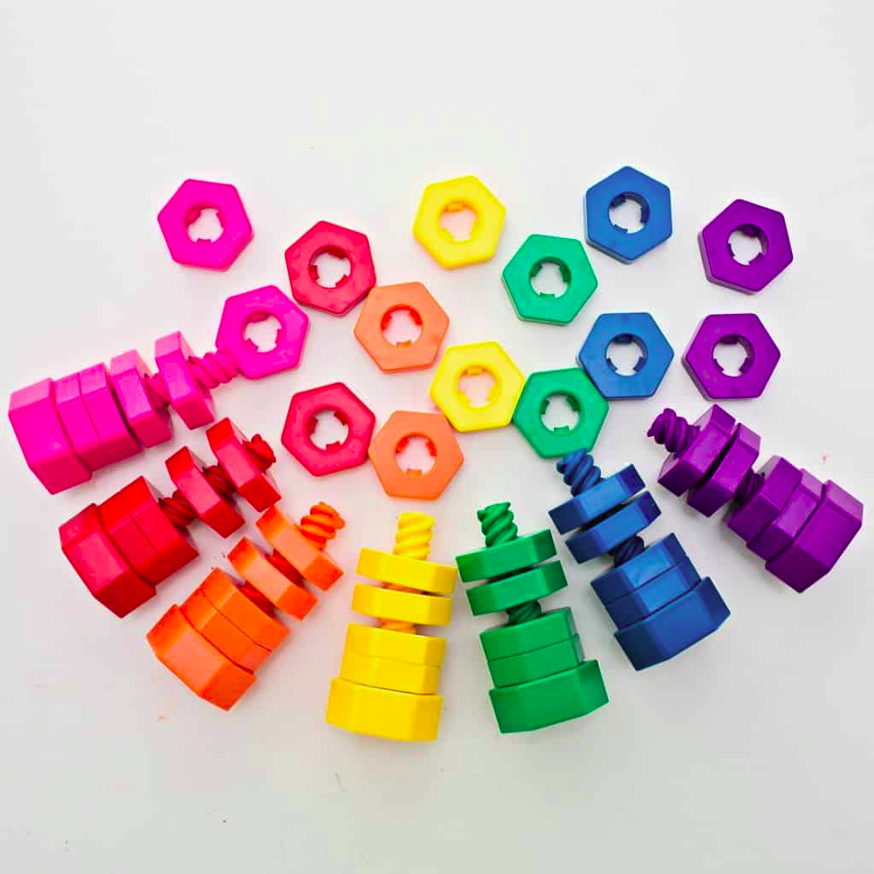
Data Structure – Sorting Techniques
Introduction
Sorting:
It is a process of arranging items systematically
Meaning:
Ordering or Arranging the items in a sequence ordered

Slide 5
Data Structure – Sorting Techniques
Introduction
Sorting Algorithm:
Is an Algorithm that puts the elements of a list in a particular order

Slide 6


Data Structure – Sorting Techniques
Introduction
Sorting Algorithm:
Is an Algorithm that puts the elements of a list in a particular order
Data Searching is optimized

Slide 7
Data Structure – Sorting Techniques
Introduction
Sorting Techniques:
Bubble Sort
Insertion Sort
Selection Sort
Quick Sort
Merge Sort
Heap Sort

Slide 8
Data Structure – Sorting Techniques
Bubble Sort
It is simple sorting technique
This sorting algorithm is comparison-based algorithm in which each pair of adjacent elements is compared and the elements are swapped if they are not in order.
Its average and worst case complexity are of Ο(n²) where n is the number of items.

Slide 9
Data Structure – Sorting Techniques
Bubble Sort
arr[SIZE]
SIZE = 5
arr[0]
arr[1]
arr[2]
arr[3]
arr[4]

Slide 10
Data Structure – Sorting Techniques
Bubble Sort
arr[SIZE]
SIZE = 5
5
1
4
2
8
5 > 1
arr[0]
arr[1]
arr[2]
arr[3]
arr[4]

Slide 11
Data Structure – Sorting Techniques
Bubble Sort
arr[SIZE]
SIZE = 5
5
1
4
2
8
5 > 1
arr[0]
arr[1]
arr[2]
arr[3]
arr[4]
1
5
4
2
8
5 > 4
arr[0]
arr[1]
arr[2]
arr[3]
arr[4]

Slide 12
Data Structure – Sorting Techniques
Bubble Sort
arr[SIZE]
SIZE = 5
5
1
4
2
8
5 > 1
arr[0]
arr[1]
arr[2]
arr[3]
arr[4]
1
5
4
2
8
5 > 4
arr[0]
arr[1]
arr[2]
arr[3]
arr[4]
1
4
5
2
8
5 > 2
arr[0]
arr[1]
arr[2]
arr[3]
arr[4]

Slide 13
Data Structure – Sorting Techniques
Bubble Sort
arr[SIZE]
SIZE = 5
5
1
4
2
8
5 > 1
arr[0]
arr[1]
arr[2]
arr[3]
arr[4]
1
5
4
2
8
5 > 4
arr[0]
arr[1]
arr[2]
arr[3]
arr[4]
1
4
5
2
8
5 > 2
arr[0]
arr[1]
arr[2]
arr[3]
arr[4]
1
4
2
5
8
5 < 8
arr[0]
arr[1]
arr[2]
arr[3]
arr[4]

Slide 14
Data Structure – Sorting Techniques
Bubble Sort
arr[SIZE]
SIZE = 5
5
1
4
2
8
5 > 1
1
4
2
5
8
1 < 4
arr[0]
arr[1]
arr[2]
arr[3]
arr[4]
arr[0]
arr[1]
arr[2]
arr[3]
arr[4]
1
5
4
2
8
5 > 4
arr[0]
arr[1]
arr[2]
arr[3]
arr[4]
1
4
5
2
8
5 > 2
arr[0]
arr[1]
arr[2]
arr[3]
arr[4]
1
4
2
5
8
5 < 8
arr[0]
arr[1]
arr[2]
arr[3]
arr[4]

Slide 15
Data Structure – Sorting Techniques
Bubble Sort
arr[SIZE]
SIZE = 5
5
1
4
2
8
5 > 1
1
4
2
5
8
1 < 4
arr[0]
arr[1]
arr[2]
arr[3]
arr[4]
arr[0]
arr[1]
arr[2]
arr[3]
arr[4]
1
5
4
2
8
5 > 4
1
4
2
5
8
4 > 2
arr[0]
arr[1]
arr[2]
arr[3]
arr[4]
arr[0]
arr[1]
arr[2]
arr[3]
arr[4]
1
4
5
2
8
5 > 2
arr[0]
arr[1]
arr[2]
arr[3]
arr[4]
1
4
2
5
8
5 < 8
arr[0]
arr[1]
arr[2]
arr[3]
arr[4]

Slide 16
Data Structure – Sorting Techniques
Bubble Sort
arr[SIZE]
SIZE = 5
5
1
4
2
8
5 > 1
1
4
2
5
8
1 < 4
arr[0]
arr[1]
arr[2]
arr[3]
arr[4]
arr[0]
arr[1]
arr[2]
arr[3]
arr[4]
1
5
4
2
8
5 > 4
1
4
2
5
8
4 > 2
arr[0]
arr[1]
arr[2]
arr[3]
arr[4]
arr[0]
arr[1]
arr[2]
arr[3]
arr[4]
1
4
5
2
8
5 > 2
1
2
4
5
8
arr[0]
arr[1]
arr[2]
arr[3]
arr[4]
arr[0]
arr[1]
arr[2]
arr[3]
arr[4]
.
.
.
1
4
2
5
8
5 < 8
.
arr[0]
arr[1]
arr[2]
arr[3]
arr[4]
.

Slide 17
Data Structure – Sorting Techniques
Algorithm
Bubble Sort(arr,size)

Slide 18
Data Structure – Sorting Techniques
Algorithm
Bubble Sort(arr,size)
for i = 0 upto size
for j = 0 upto size-1-i
If (arr[j] > arr[j+1])
temp = arr[j]
arr[j] = arr[j+1]
arr[j+1] = temp
return e_true

Slide 19
Data Structure – Sorting Techniques
Bubble Sort
Advantages
It is easy to implement
Elements are swapped in place without using additional temporary storage.
The space requirement is at a minimum

Slide 20
Data Structure – Sorting Techniques
Bubble Sort
Advantages
It is easy to implement
Elements are swapped in place without using additional temporary storage.
The space requirement is at a minimum
Disadvantages
The bubble sort requires n-squared processing steps for every n number of elements to be sorted.
Time complexity = O(n²)

Slide 21
Code -Bubble Sort

